Slide 1
The Economist’s COVID-19 Excess Deaths Tracker
Ansaar Dollie

Slide 2
Agenda
Introduction & Problem Statement
The Economist’s Methodology
Overview
Data & Assumptions
Shortcomings
Validation (Back-of-the-envelope)
Discussion
Concluding Remarks

Slide 3

Introduction
The pandemic has had a massive effect on global mortality.
Accurate reflection of these effects are necessary to inform countries’ responses (i.e. national regulations / resource allocation / intervention efficacy / acknowledge the huge magnitude of loss of life.
Excess deaths is generally accepted as a valid reflection of abnormal mortality levels during times of crisis
(Source: https://covid19.who.int/)

Slide 4

Introduction – Excess Mortality / Death
Excess mortality : “Mortality above what would be expected based on the non-crisis mortality rate in the population of interest. Excess mortality is thus mortality that is attributable to the crisis conditions. It can be expressed as a rate (the difference between observed and non-crisis mortality rates), or as a total number of excess deaths.” (World Health Organisation)
Can be calculated at sub-national, national or global level

Slide 5
Introduction – Excess Mortality / Death
What is needed to calculated excess deaths
Accurate, reliable and up-to date tabulated death data
A chosen definition of ‘expected mortality’
Expected mortality, usually is the prediction outputs from one of the following models trained on historical (non-crisis) data
Regression Models
Time Series Models
Machine Learning / AI Models
Difficulty in estimating global excess mortality lies in the fact that the data needed is not available for many countries.
The Economist’s model aims to get around this issue using machine learning.

Slide 6
PROBLEM STATEMENT
“Validate and critique The Economist’s pandemic excess deaths modeling methodology”

Slide 7
Agenda
Introduction & Problem Statement
The Economist’s Methodology
Overview
Data & Assumptions
Shortcomings
Validation (Back-of-the-envelope)
Discussion
Concluding Remarks

Slide 8
The Economist’s Methodology - Overview
Model A – Data Available
Model B – Data Unavailable
World Mortality Dataset
112 Countries
Weekly/Quarterly/Monthly
Sometimes subdivided by sub-national region
Expected deaths is fit using linear model (OLS), with year & time unit (week/quarter/month) as predictors
Time unit is used as a fixed/categorical predictor as opposed to continuous
Inputs:
Model A
Lots of other predictors
Uses this data to train a machine learning model to predict excess deaths for training data.
XGBoost (eXtreme Gradient Boosting)
Clearly very sensitive to input
Many hyperparemeters

Slide 9
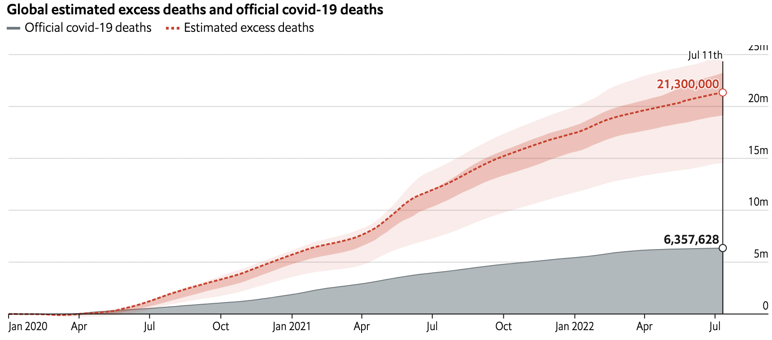
The Economist’s Methodology - Overview

Slide 10
The Economist’s Methodology - Overview
Expected Mortality Assumptions
Known Mortality Data
Time Series Indicators
Static Indicators
‘Accepted’ Excess Deaths Model
Known Countries’ Related Indicators/Predictors
ML Model for Excess Deaths
Unknown Countries’ Related Indicators / Predictors
Global Excess Death Estimates
Excess Death Predictions

Slide 11
Agenda
Introduction & Problem Statement
The Economist’s Methodology
Overview
Data & Assumptions
Shortcomings
Validation (Back-of-the-envelope)
Discussion
Concluding Remarks

Slide 12
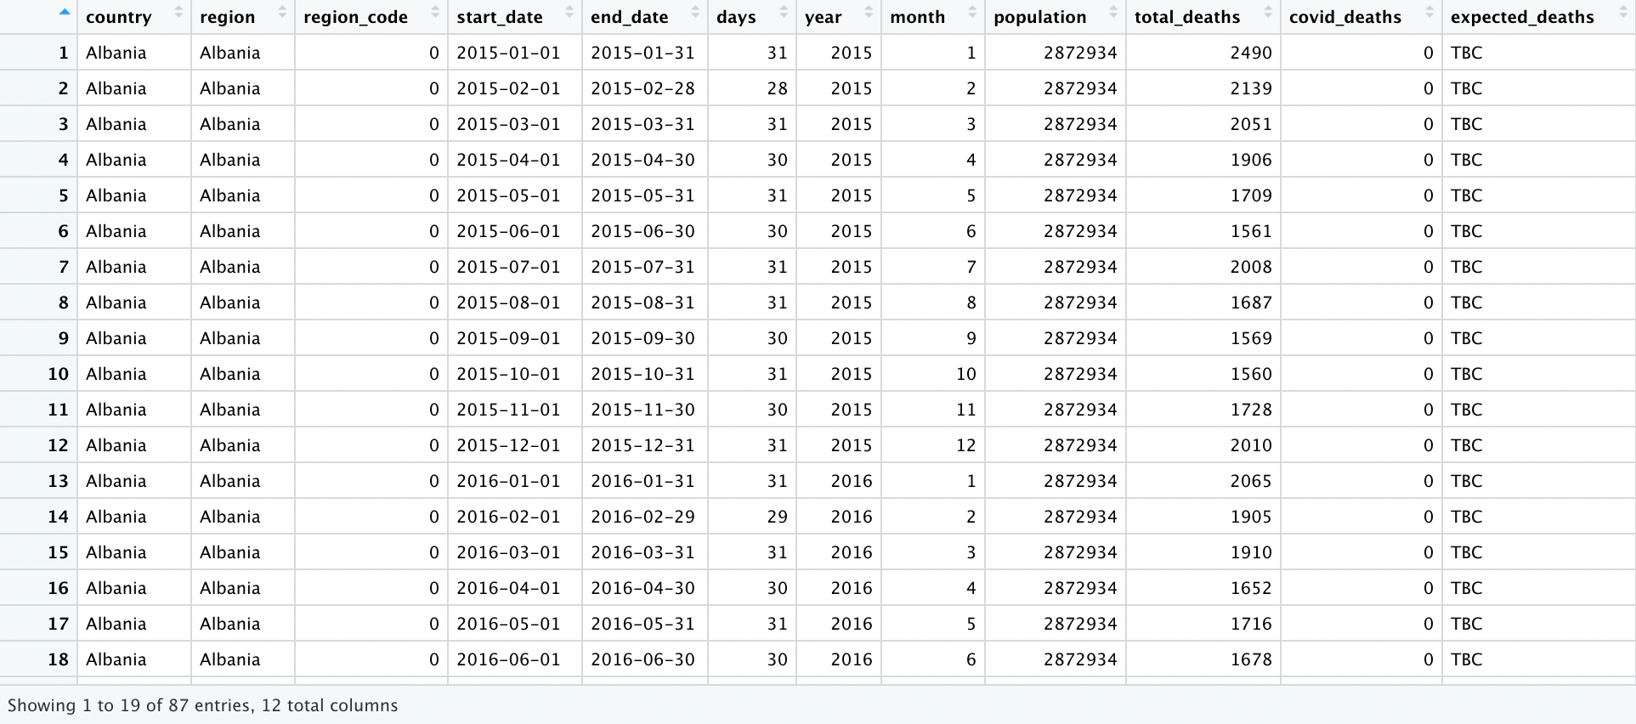
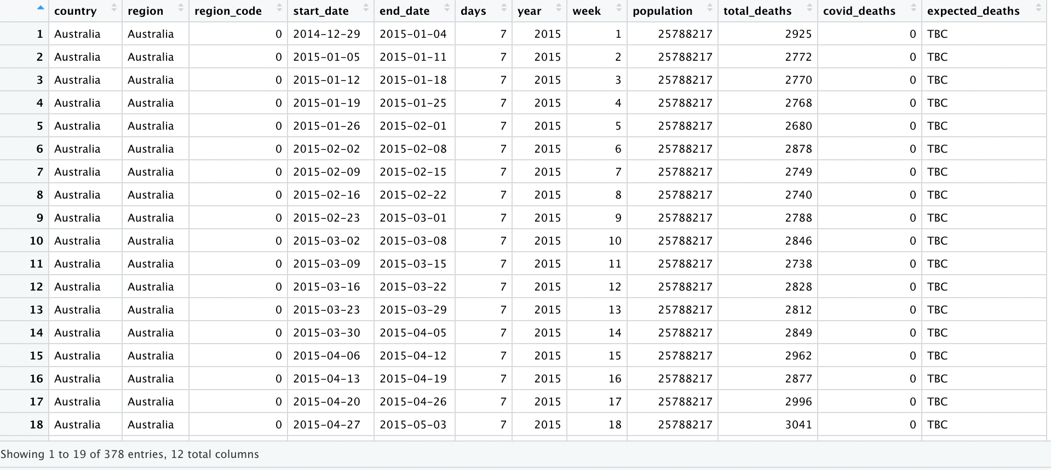
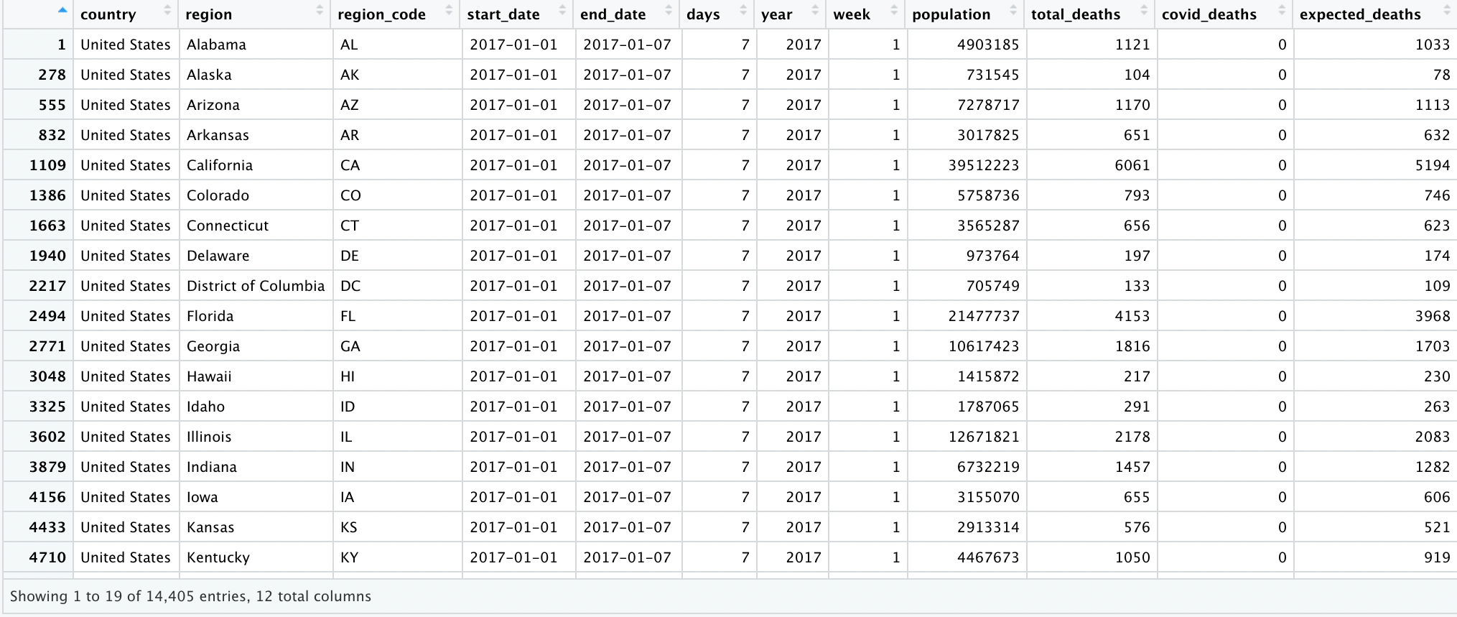
Excess Deaths Model A – Data & Assumptions
Gather as much data on death records as possible.
World Mortality Dataset + National Death Registries
113 Countries
Differing time periods (week/quarter/month)
Records date back to beginning of 2015
All-cause VS Natural Deaths
Sex/Age Differentiation

Slide 13
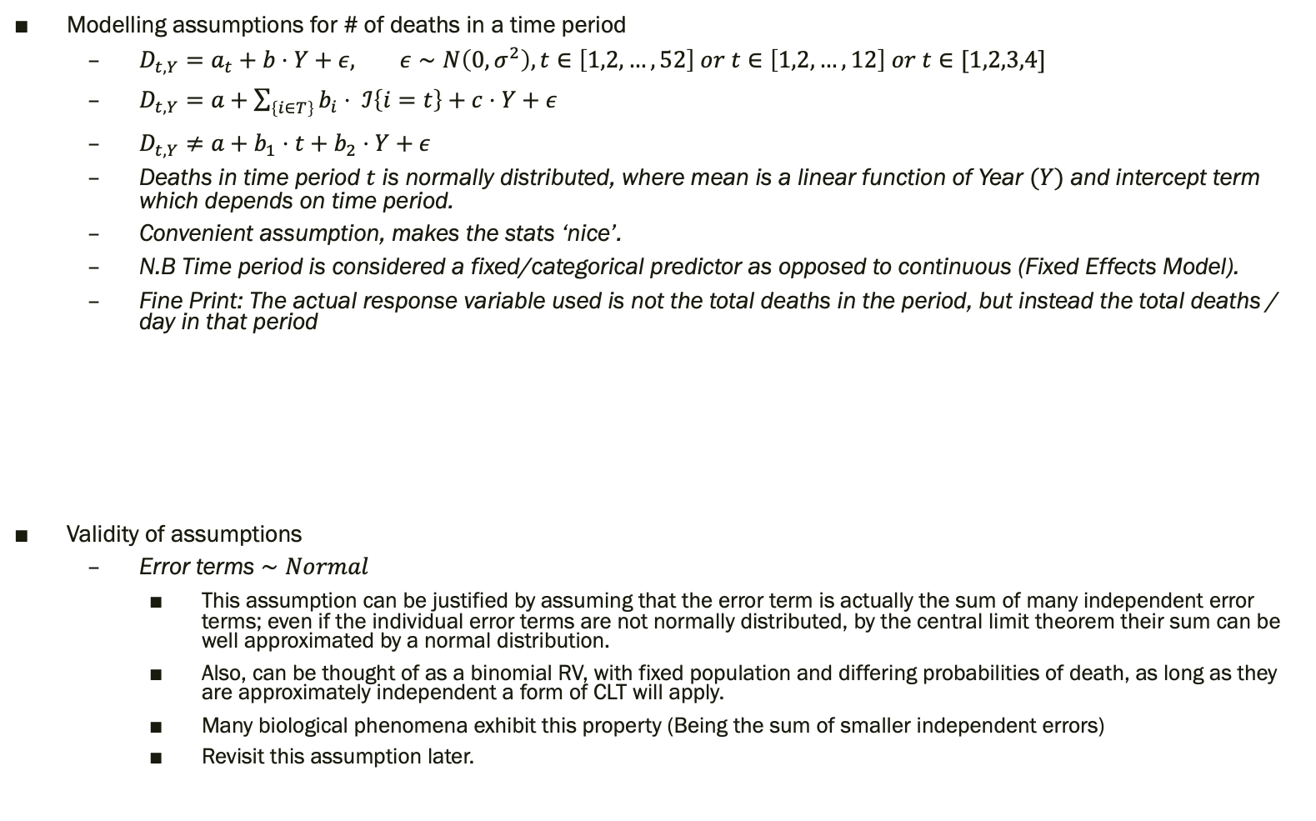
Excess Deaths Model A – Data & Assumptions
Modelling assumptions for # of deaths in a time period
$D_{t,Y}=a_{t}+b⋅Y+ε, ε∼N\left(0,σ^{2}\right), t∈\left[1,2,…,52\right] or t∈\left[1,2, …, 12\right] or t∈[1,2,3,4]$
$D_{t,Y}=a+\sum_{\left\{i∈T\right\}}{b_{i}⋅ ℐ\left\{i=t\right\}+c⋅Y+ε}$
$D_{t,Y}≠a+b_{1}⋅t+b_{2}⋅Y+ε$
Deaths in time period $t$ is normally distributed, where mean is a linear function of Year $(Y)$ and intercept term which depends on time period.
Convenient assumption, makes the stats ‘nice’.
N.B Time period is considered a fixed/categorical predictor as opposed to continuous (Fixed Effects Model).
Fine Print: The actual response variable used is not the total deaths in the period, but instead the total deaths / day in that period
Validity of assumptions
Error terms $∼Normal$
This assumption can be justified by assuming that the error term is actually the sum of many independent error terms; even if the individual error terms are not normally distributed, by the central limit theorem their sum can be well approximated by a normal distribution.
Also, can be thought of as a binomial RV, with fixed population and differing probabilities of death, as long as they are approximately independent a form of CLT will apply.
Many biological phenomena exhibit this property (Being the sum of smaller independent errors)
Revisit this assumption later.
train_df <- df %>%
filter(week != "53") %>%
bind_rows(week_53_df) %>%
filter(end_date < as.Date("2020-03-01")) %>%
mutate(total_deaths_per_day = total_deaths / days)
(Source: https://github.com/TheEconomist/covid-19-excess-deaths-tracker/blob/master/scripts/excess_deaths_script.R)

Slide 14
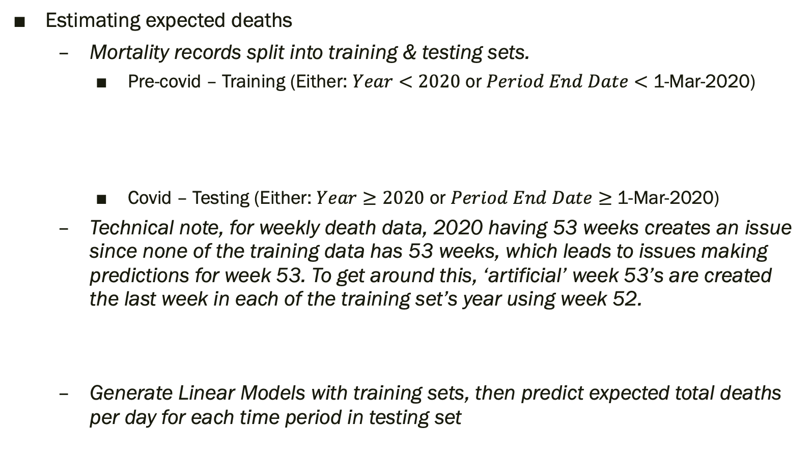
Excess Deaths Model A – Data & Assumptions
Estimating expected deaths
Mortality records split into training & testing sets.
Pre-covid – Training (Either: $Year<2020$ or $Period End Date<$ 1-Mar-2020)
Covid – Testing (Either: $Year≥2020$ or $Period End Date≥$ 1-Mar-2020)
Technical note, for weekly death data, 2020 having 53 weeks creates an issue since none of the training data has 53 weeks, which leads to issues making predictions for week 53. To get around this, ‘artificial’ week 53’s are created the last week in each of the training set’s year using week 52.
Generate Linear Models with training sets, then predict expected total deaths per day for each time period in testing set
train_df <- df %>%
filter(week != "53") %>%
bind_rows(week_53_df) %>%
filter(end_date < as.Date("2020-03-01")) %>%
mutate(total_deaths_per_day = total_deaths / days)
(Source: https://github.com/TheEconomist/covid-19-excess-deaths-tracker/blob/master/scripts/excess_deaths_script.R)
week_53_df <- df %>%
filter(week %in% c("52","53")) %>% mutate(week = "53", week_53 = 1)
(Source: https://github.com/TheEconomist/covid-19-excess-deaths-tracker/blob/master/scripts/excess_deaths_script.R)
expected_deaths_model <- lm(expected_deaths_formula,train_df)
expected_deaths <- df %>% filter(year >= 2020) %>%
mutate(expected_deaths = predict(expected_deaths_model,newdata=.) * days)
(Source: https://github.com/TheEconomist/covid-19-excess-deaths-tracker/blob/master/scripts/excess_deaths_script.R)

Slide 15
Excess Deaths Model A – Data & Assumptions
Once expected deaths have been estimated, excess deaths can be calculated as the difference between observed deaths and expected deaths.
Once excess death data has been estimated, these are then fed into Model B to generate excess death estimates for countries without accurate death tables.
excess_deaths <- expected_deaths %>%
mutate(excess_deaths = total_deaths - expected_deaths,
non_covid_deaths = total_deaths - covid_deaths,
region_code = as.character(region_code)) %>%
mutate(covid_deaths_per_100k = covid_deaths / population * 100000,
excess_deaths_per_100k = excess_deaths / population * 100000,
excess_deaths_pct_change = ((expected_deaths + excess_deaths) / expected_deaths) - 1)
(Source: https://github.com/TheEconomist/covid-19-excess-deaths-tracker/blob/master/scripts/excess_deaths_script.R)

Slide 16
Excess Deaths Model B – Data & Assumptions
Model B responsible for generating excess death estimates for countries without accurate death tables.
This achieved by training a machine learning model using ‘known’ excess death data along with a vast selection of other indicators which are known for both groups of countries.
Indicators used:
Indicator | Source(s)
Covid-19 data (deaths, cases, testing, and vaccinations) | Our World In Data; Johns Hopkins University, CSSE
Prevalence of covid-19 antibodies | SeroTracker.com
Demography and urbanization rates | Our World in Data, World Bank, United Nations
Demography-adjusted infection fatality rate | The Economist, based on Brazeau et al. (2020) and UN population figures
Healthcare quality | Our World in Data, World Bank
Political regime and media freedom data | V-Dem Institute, PolityIV Project, Freedom House, Boix et al (2015)
Economy and connectivity | World Bank, Our World in Data, World Tourism Organization
Mobility | COVID-19 Community Mobility Reports (Google)
Geography | Decker et al (“maps” R package), Mayer T et al (2011)
Government policy responses to Covid-19 | OxCGRT (University of Oxford)
(Source: https://www.economist.com/graphic-detail/2021/05/13/how-we-estimated-the-true-death-toll-of-the-pandemic)

Slide 17
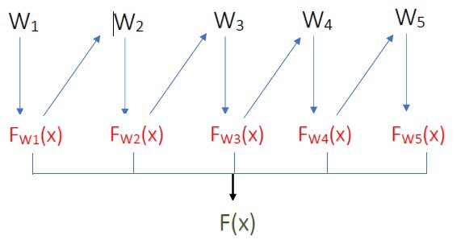
Excess Deaths Model B – Data & Assumptions
Machine Learning Model trained on Model A outputs + other indicators.
Selected Model: XGBoost (eXtreme Gradient Boosting)
Very popular ML model
Gradient Boosting algorithm
Create sequential set of decision trees, where each subsequent tree is used to fit the error of the prediction made by all previous trees.
Regularized algorithm, avoids overfitting and improves prediction errors
Robust to collinearity and missing values
Main hyperparameters:
# of sub-trees
Learning Rate
10-fold Cross Validation

Slide 18
Agenda
Introduction & Problem Statement
The Economist’s Methodology
Overview
Data & Assumptions
Shortcomings
Validation (Back-of-the-envelope)
Discussion
Concluding Remarks

Slide 19
Excess Deaths Model A – Shortcomings
Data Collection
Reporting delays for death data
Time period mismatch
Historical death data, mostly classified by date of occurrence
COVID deaths, classified by date of reporting
Economist’s models do not account for this, while some other models do
All-cause VS natural deaths
All-cause mortality includes natural (old-age, disease, illness, etc) and unnatural (accidents, homicides, suicides, etc)
Proportion of natural VS unnatural deaths will vary from country to country and depends on various endogenous factors, which are not accounted for in The Economist’s models
No sex/age stratification
Lumping all mortality together, could conceal any trends due to the age/sex make-up of countries (younger populations tend to fare better with COVID mortality)

Slide 20
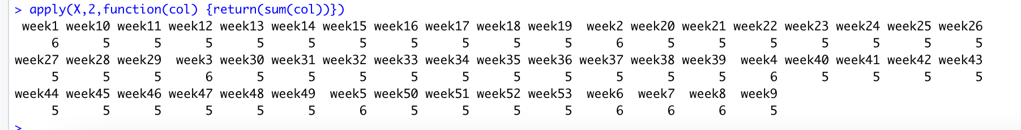
Excess Deaths Model A – Shortcomings
Modelling Assumptions
Normal Distribution
No real justification given for this assumption.
Technical note, death counts are always positive integers. Normal distribution assumption means non-zero probability of negative deaths.
Homoscedasticity of error term variances is a crucial assumption in OLS
Unrealistic assumption, consider the variance of deaths in week 52 (Christmas time) VS variance in week 11 (Middle of March). Unlikely to be equal.
Statistical Issues
# of samples in fixed effects model
Since the time period (week/month/quarter) within a year is considered fixed, essentially the regression for each period is only calculated using samples from that time period in each year. In other words, essentially there are 52/12/4 different regressions being done, one for each time period with each year’s period being a sample point.
This means there is a small sample size being used for each regression

Slide 21
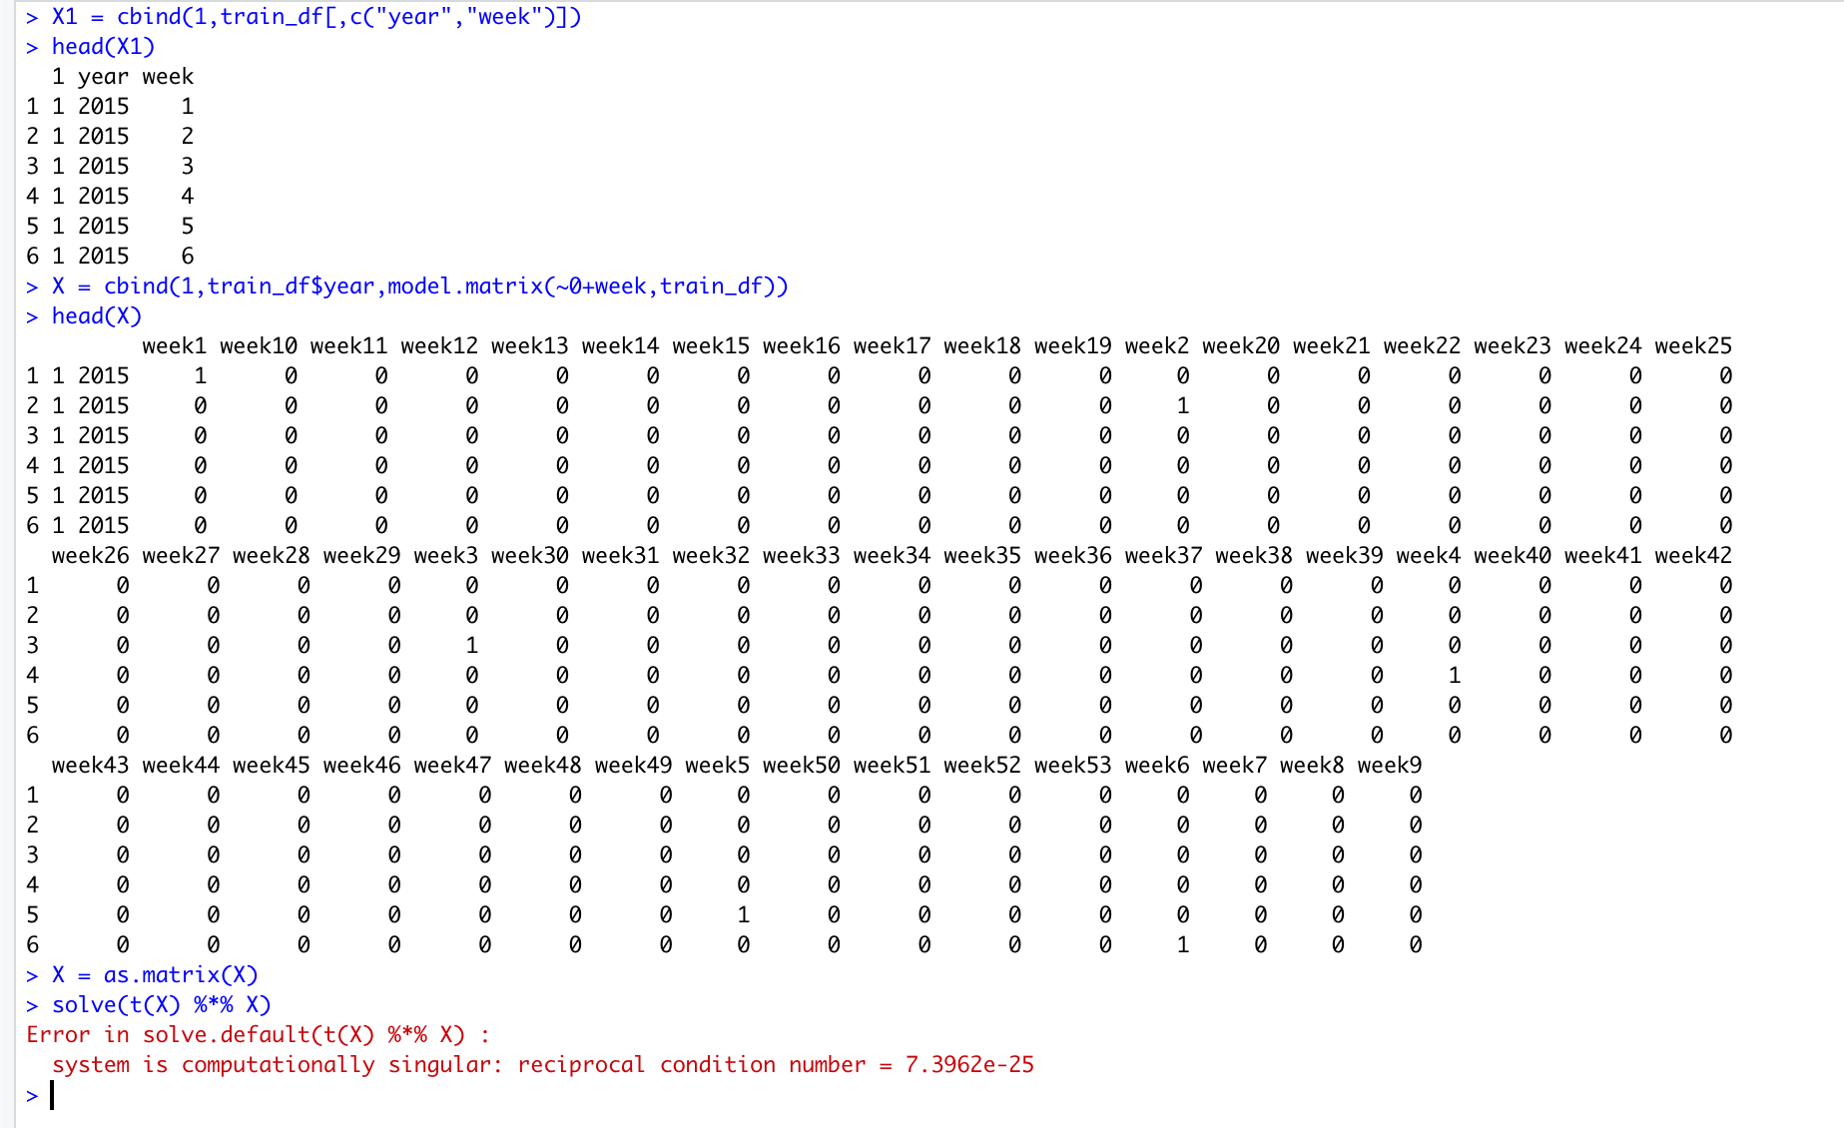
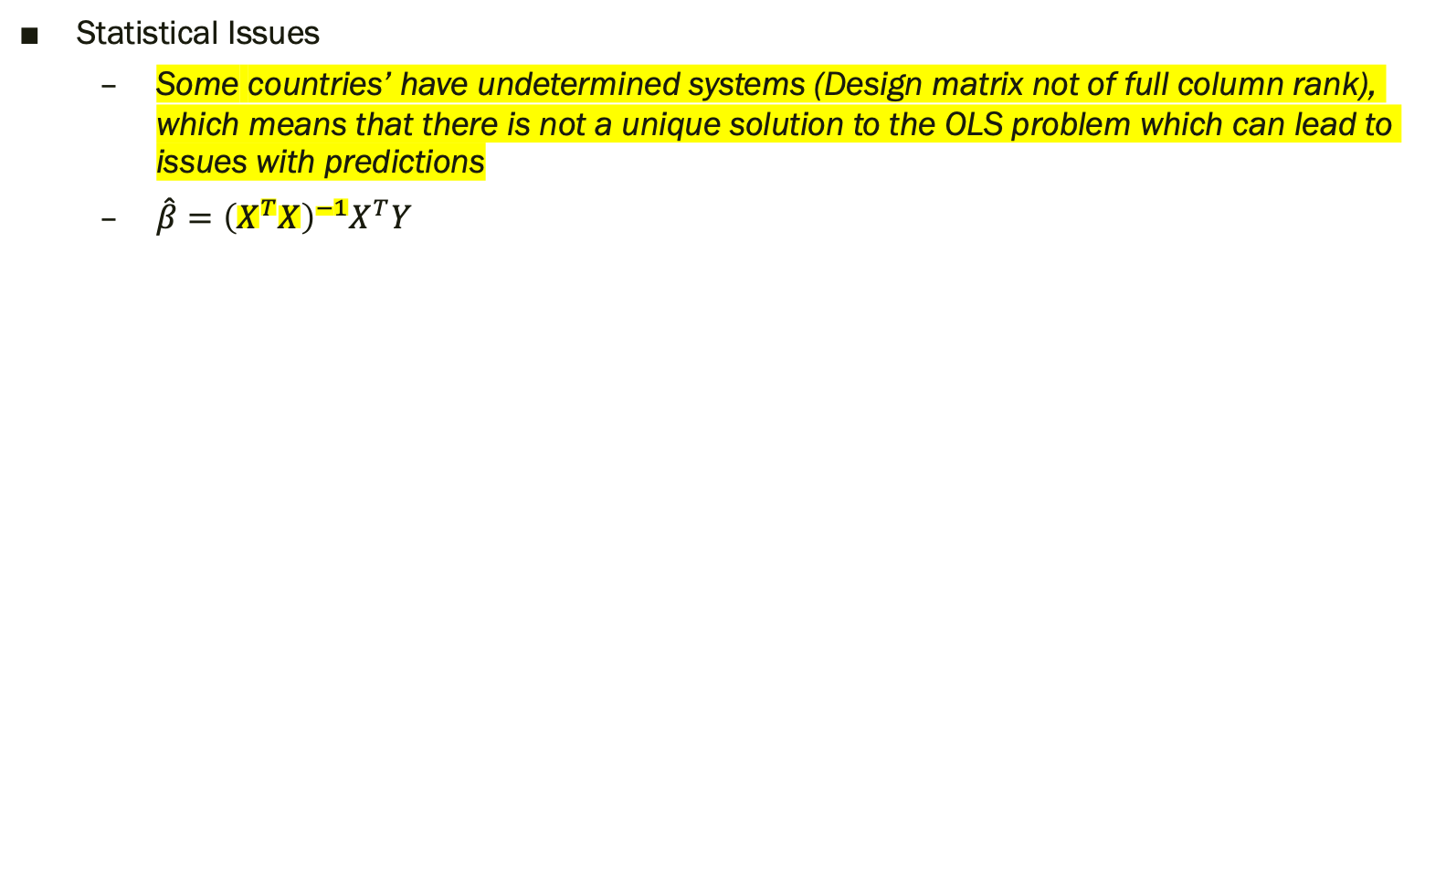
Excess Deaths Model A – Shortcomings
Statistical Issues
Some countries’ have undetermined systems (Design matrix not of full column rank), which means that there is not a unique solution to the OLS problem which can lead to issues with predictions
$\hat{β}={\left(X^{T}X\right)}^{−1}X^{T}Y$

Slide 22
Excess Deaths Model B – Shortcomings
Input Sensitivity
ML model using output from previous step as ‘true’ outcomes
Changes in excess death estimates (due to different models/assumptions) leads to different estimates for global excess deaths
Black-box nature of ML model
Highly complex algorithm
Using a model unfit for purpose
Hyperparameter selection, tuning the model to output data you want

Slide 23
Agenda
Introduction & Problem Statement
The Economist’s Methodology
Overview
Data & Assumptions
Shortcomings
Validation (Back-of-the-envelope)
Discussion
Concluding Remarks

Slide 24
Model VALIDATIONS

Slide 25
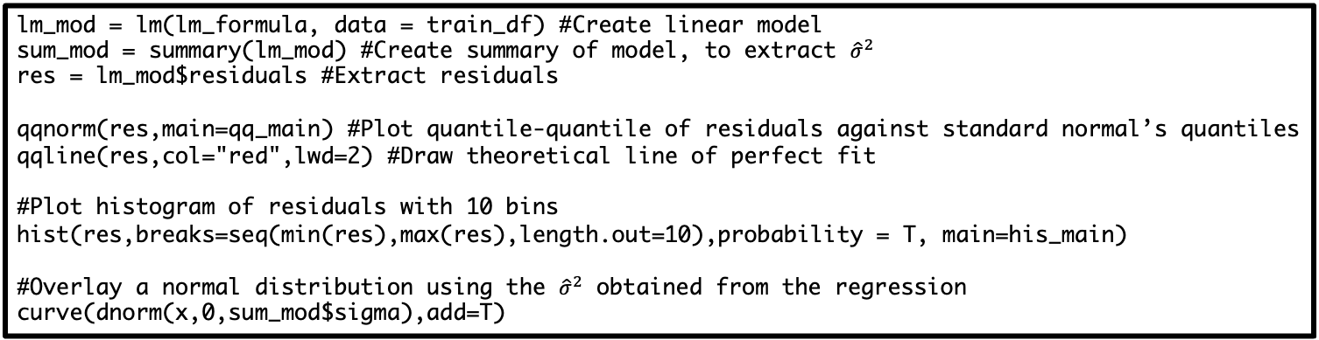
Normal Errors
Check whether residual terms are in fact normally distributed
QQ Plot
Histogram
lm_mod = lm(lm_formula, data = train_df) #Create linear model
sum_mod = summary(lm_mod) #Create summary of model, to extract ${\hat{σ}}^{2}$
res = lm_mod$residuals #Extract residuals
qqnorm(res,main=qq_main) #Plot quantile-quantile of residuals against standard normal’s quantiles
qqline(res,col="red",lwd=2) #Draw theoretical line of perfect fit
#Plot histogram of residuals with 10 bins
hist(res,breaks=seq(min(res),max(res),length.out=10),probability = T, main=his_main)
#Overlay a normal distribution using the ${\hat{σ}}^{2}$ obtained from the regression
curve(dnorm(x,0,sum_mod$sigma),add=T)

Slide 26
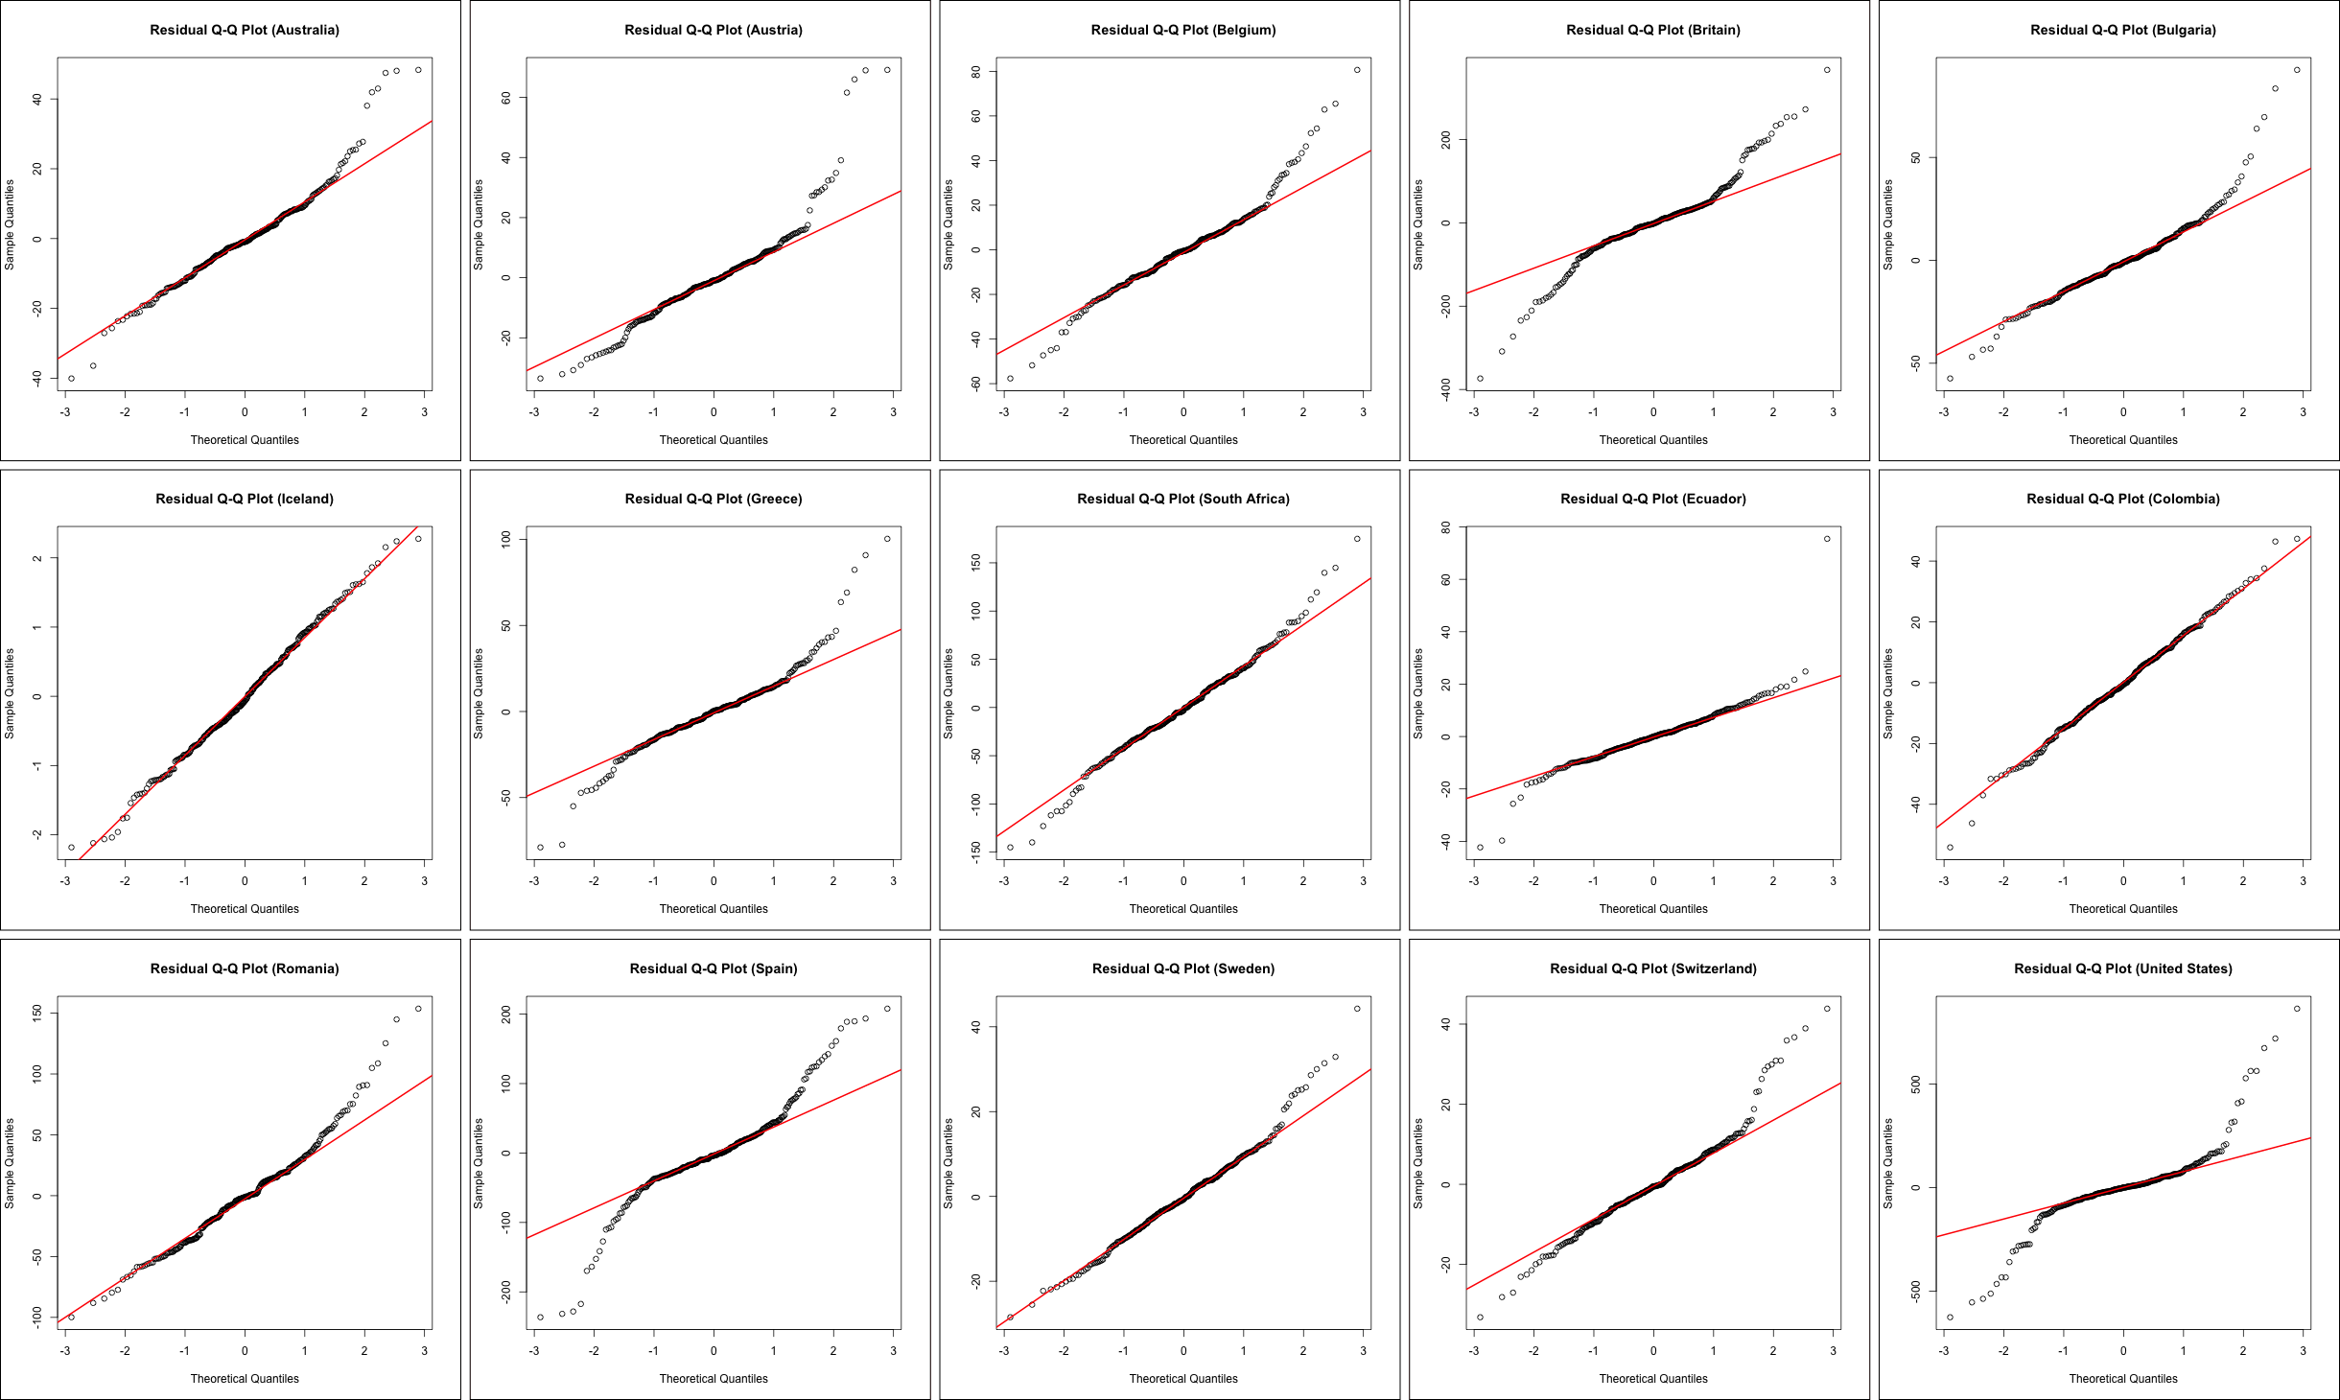
QQ - Plots

Slide 27
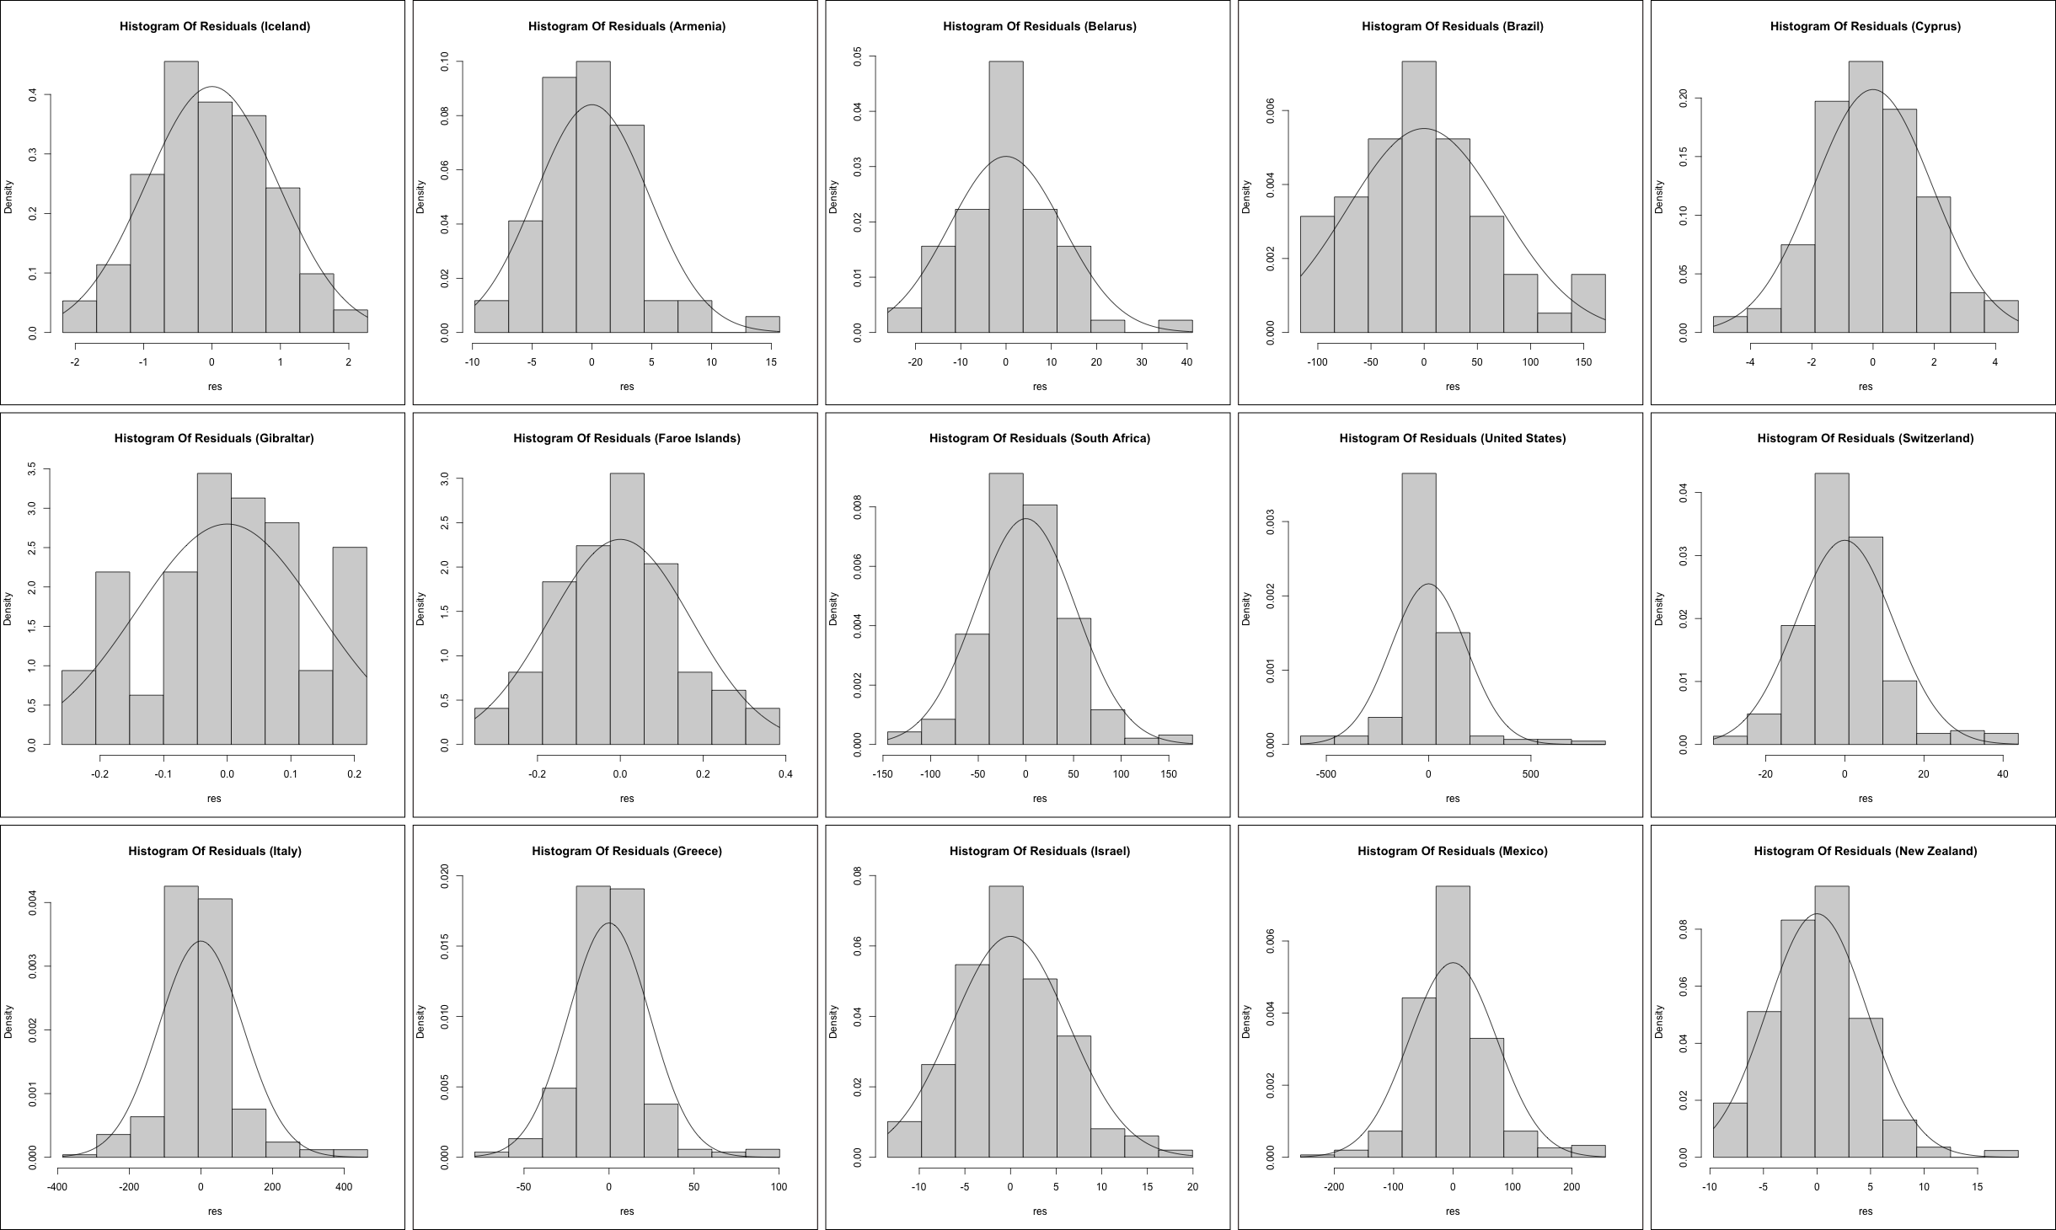
Histograms - Plots

Slide 28
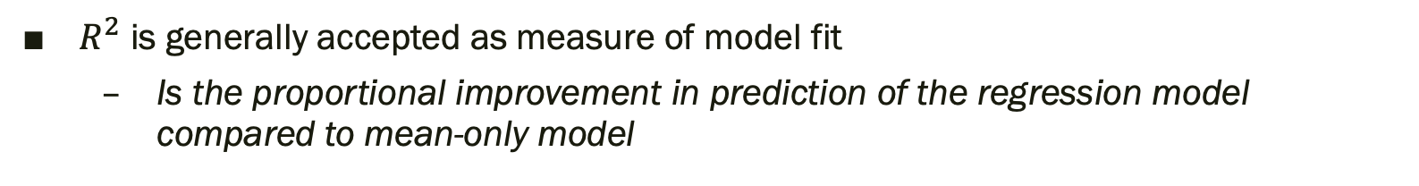
Model Fits
$R^{2}$ is generally accepted as measure of model fit
Is the proportional improvement in prediction of the regression model compared to mean-only model
countries = dir("./data/historical-deaths")
r2 = data.frame(country=c(),r_squared=c())
for(f in countries) {
path = paste("./data/historical-deaths/",f,sep="")
data = read.csv(path)
print(path)
freq = colnames(data)[8]
colnames(data)[8] = "time"
data$time = as.factor(data$time)
country = data$country[1]
lm_formula = as.formula(total_deaths_per_day ~ year + time)
if (weekly) {
week_53_df = data %>%
filter(time %in% c("52","53")) %>% mutate(time = "53", week_53 = 1)
train_df = data %>%
filter(time != "53") %>%
bind_rows(week_53_df) %>%
filter(year < 2020) %>%
mutate(total_deaths_per_day = total_deaths / days)
} else {
train_df = data %>%
filter(year < 2020) %>%
mutate(total_deaths_per_day = total_deaths / days)
}
lm_mod = lm(lm_formula, data = train_df)
sum_mod = summary(lm_mod)
r2 = rbind(r2,c(country,sum_mod$r.squared))
}
colnames(r2) = c("Country","R Squared")
r2 = r2[order(r2$`R Squared`),]

Slide 29
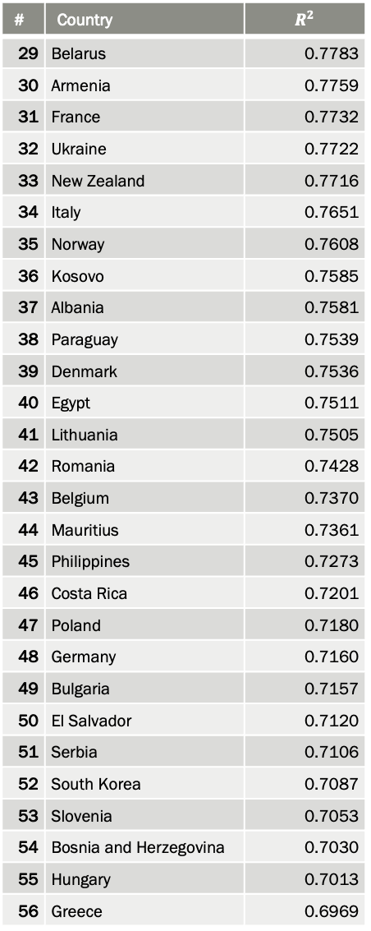
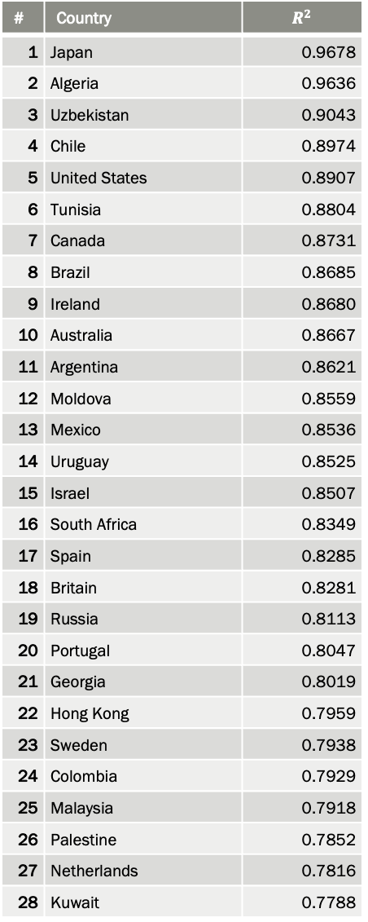
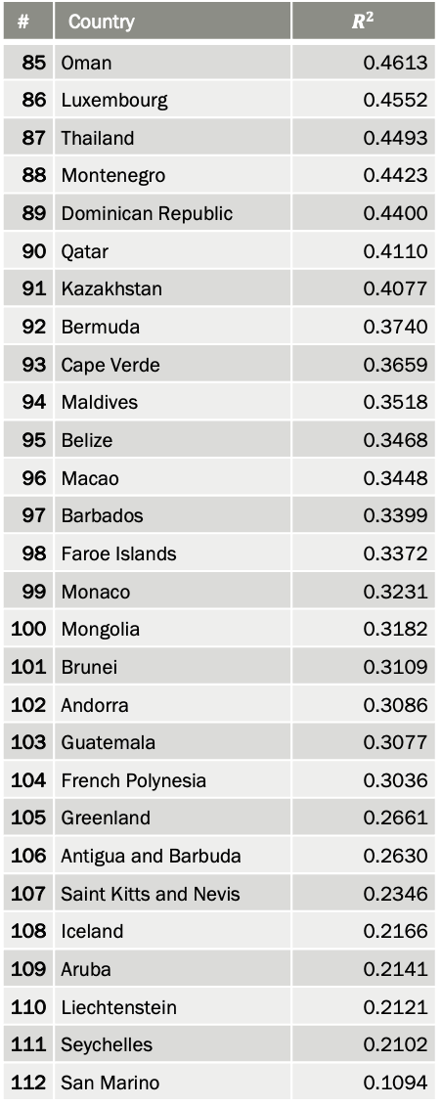
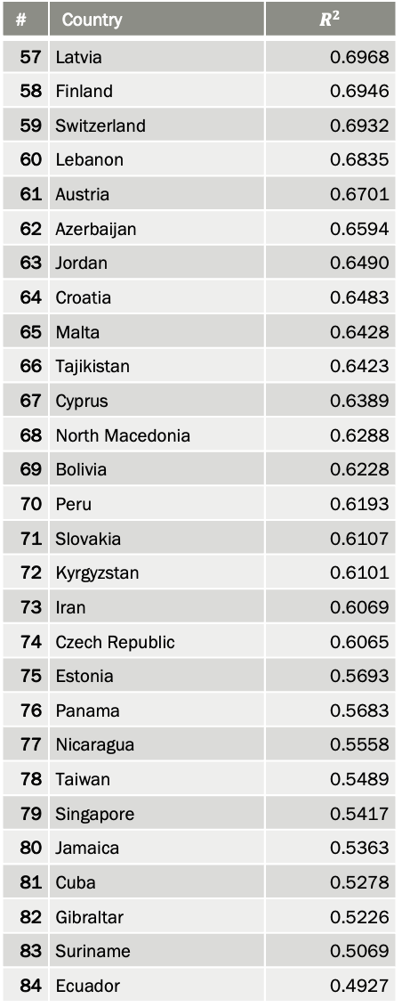
# | Country | $$R^{2}$$
1 | Japan | 0.9678
2 | Algeria | 0.9636
3 | Uzbekistan | 0.9043
4 | Chile | 0.8974
5 | United States | 0.8907
6 | Tunisia | 0.8804
7 | Canada | 0.8731
8 | Brazil | 0.8685
9 | Ireland | 0.8680
10 | Australia | 0.8667
11 | Argentina | 0.8621
12 | Moldova | 0.8559
13 | Mexico | 0.8536
14 | Uruguay | 0.8525
15 | Israel | 0.8507
16 | South Africa | 0.8349
17 | Spain | 0.8285
18 | Britain | 0.8281
19 | Russia | 0.8113
20 | Portugal | 0.8047
21 | Georgia | 0.8019
22 | Hong Kong | 0.7959
23 | Sweden | 0.7938
24 | Colombia | 0.7929
25 | Malaysia | 0.7918
26 | Palestine | 0.7852
27 | Netherlands | 0.7816
28 | Kuwait | 0.7788
# | Country | $$R^{2}$$
29 | Belarus | 0.7783
30 | Armenia | 0.7759
31 | France | 0.7732
32 | Ukraine | 0.7722
33 | New Zealand | 0.7716
34 | Italy | 0.7651
35 | Norway | 0.7608
36 | Kosovo | 0.7585
37 | Albania | 0.7581
38 | Paraguay | 0.7539
39 | Denmark | 0.7536
40 | Egypt | 0.7511
41 | Lithuania | 0.7505
42 | Romania | 0.7428
43 | Belgium | 0.7370
44 | Mauritius | 0.7361
45 | Philippines | 0.7273
46 | Costa Rica | 0.7201
47 | Poland | 0.7180
48 | Germany | 0.7160
49 | Bulgaria | 0.7157
50 | El Salvador | 0.7120
51 | Serbia | 0.7106
52 | South Korea | 0.7087
53 | Slovenia | 0.7053
54 | Bosnia and Herzegovina | 0.7030
55 | Hungary | 0.7013
56 | Greece | 0.6969
# | Country | $$R^{2}$$
57 | Latvia | 0.6968
58 | Finland | 0.6946
59 | Switzerland | 0.6932
60 | Lebanon | 0.6835
61 | Austria | 0.6701
62 | Azerbaijan | 0.6594
63 | Jordan | 0.6490
64 | Croatia | 0.6483
65 | Malta | 0.6428
66 | Tajikistan | 0.6423
67 | Cyprus | 0.6389
68 | North Macedonia | 0.6288
69 | Bolivia | 0.6228
70 | Peru | 0.6193
71 | Slovakia | 0.6107
72 | Kyrgyzstan | 0.6101
73 | Iran | 0.6069
74 | Czech Republic | 0.6065
75 | Estonia | 0.5693
76 | Panama | 0.5683
77 | Nicaragua | 0.5558
78 | Taiwan | 0.5489
79 | Singapore | 0.5417
80 | Jamaica | 0.5363
81 | Cuba | 0.5278
82 | Gibraltar | 0.5226
83 | Suriname | 0.5069
84 | Ecuador | 0.4927
# | Country | $$R^{2}$$
85 | Oman | 0.4613
86 | Luxembourg | 0.4552
87 | Thailand | 0.4493
88 | Montenegro | 0.4423
89 | Dominican Republic | 0.4400
90 | Qatar | 0.4110
91 | Kazakhstan | 0.4077
92 | Bermuda | 0.3740
93 | Cape Verde | 0.3659
94 | Maldives | 0.3518
95 | Belize | 0.3468
96 | Macao | 0.3448
97 | Barbados | 0.3399
98 | Faroe Islands | 0.3372
99 | Monaco | 0.3231
100 | Mongolia | 0.3182
101 | Brunei | 0.3109
102 | Andorra | 0.3086
103 | Guatemala | 0.3077
104 | French Polynesia | 0.3036
105 | Greenland | 0.2661
106 | Antigua and Barbuda | 0.2630
107 | Saint Kitts and Nevis | 0.2346
108 | Iceland | 0.2166
109 | Aruba | 0.2141
110 | Liechtenstein | 0.2121
111 | Seychelles | 0.2102
112 | San Marino | 0.1094

Slide 30
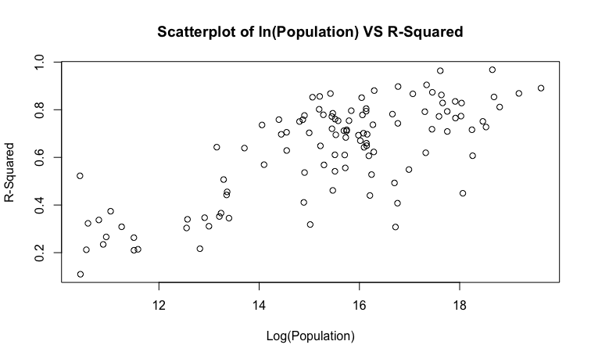
Model Fits

Slide 31
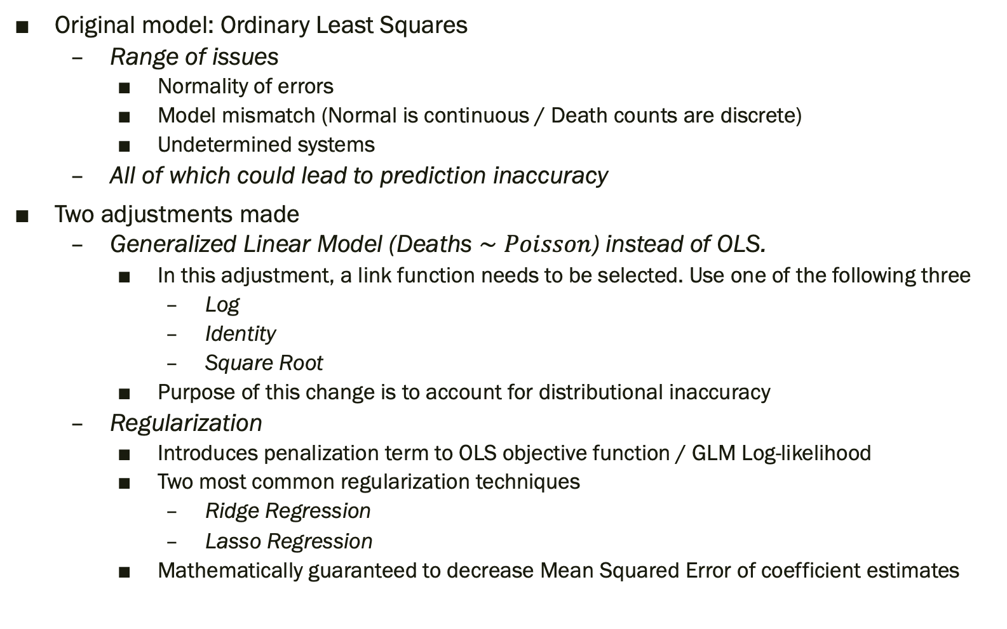
Expected Deaths Model Selection
Original model: Ordinary Least Squares
Range of issues
Normality of errors
Model mismatch (Normal is continuous / Death counts are discrete)
Undetermined systems
All of which could lead to prediction inaccuracy
Two adjustments made
Generalized Linear Model (Deaths $∼Poisson$) instead of OLS.
In this adjustment, a link function needs to be selected. Use one of the following three
Log
Identity
Square Root
Purpose of this change is to account for distributional inaccuracy
Regularization
Introduces penalization term to OLS objective function / GLM Log-likelihood
Two most common regularization techniques
Ridge Regression
Lasso Regression
Mathematically guaranteed to decrease Mean Squared Error of coefficient estimates

Slide 32
Validation Code
data = read.csv(“./data/historical-deaths/south_africa_weekly_deaths.csv")
weekly=T
colnames(data)[8] = "time"
data$time = as.factor(data$time)
lm_formula = as.formula(total_deaths_per_day ~ year + time)
glm_formula = as.formula(total_deaths ~ year + time)
Reads in data
Since working with SA data, sets ‘weekly’ flag to true
Minor data manipulation
Change ‘week’/’month’/’quarter’ column to ‘time’ makes model formula easier
Ensures ‘time’ column is interpreted as factor/category as opposed to numeric data
Creates formula object to use for model creation later

Slide 33
Validation Code
if (weekly) {
week_53_df = data %>%
filter(time %in% c("52","53")) %>% mutate(time = "53", week_53 = 1)
train_df = data %>%
filter(time != "53") %>%
bind_rows(week_53_df) %>%
filter(year < 2020) %>%
mutate(total_deaths_per_day = total_deaths / days)
} else {
train_df = data %>%
filter(year < 2020) %>%
mutate(total_deaths_per_day = total_deaths / days)
}
Creates training data set
If death data is recorded weekly, then does the same fix that The Economist uses to get around week 53 issue
Also creates imputed column called ‘total_deaths_per_day’ which is used by the normal OLS model as the response variable

Slide 34
Validation Code
if (weekly) {
week_53_df = data %>%
filter(time %in% c("52","53")) %>% mutate(time = "53", week_53 = 1)
train_df = data %>%
filter(time != "53") %>%
bind_rows(week_53_df) %>%
filter(year < 2020) %>%
mutate(total_deaths_per_day = total_deaths / days)
} else {
train_df = data %>%
filter(year < 2020) %>%
mutate(total_deaths_per_day = total_deaths / days)
}
test_df = data %>% filter(year >= 2020)
Creates training data set
If death data is recorded weekly, then does the same fix that The Economist uses to get around week 53 issue
Also creates imputed column called ‘total_deaths_per_day’ which is used by the normal OLS model as the response variable
Creates testing data set

Slide 35
Validation Code
TimeOHEC = model.matrix(~0+time,data=train_df)
X = cbind(train_df$year, TimeOHEC)
Y = as.matrix(train_df$total_deaths_per_day)
Y_glm = as.matrix(train_df$total_deaths)
lambdas = 10^(seq(-5,5,by=0.01))
test_TimeOHEC = model.matrix(~0+time,data=test_df)
test_X = cbind(test_df$year,test_TimeOHEC)
Ridge/Lasso regression library functions require categorical variables to be one-hot-encoded.
They also don’t use normal formula objects like ‘lm’ / ‘glm’ functions and instead need a design matrix and a response vector
Create a range of possible lambda parameters to use in the tuning process for ridge/lasso regression
When making predictions the ridge/lasso regression library functions need the data to be in the same format as the training data, so make a one-hot-encoded design matrix for the testing data set

Slide 36
Validation Code – Normal Model (No Reg.)
crit.val = qnorm(0.025,low=F)
lm_mod = lm(lm_formula, data = train_df)
lm_pred = predict(lm_mod,newdata = test_df,se.fit=T)
lm_expected = lm_pred$fit * test_df$days
lm_upper = (lm_pred$fit + crit.val * lm_pred$se.fit) * test_df$days
lm_lower = (lm_pred$fit - crit.val * lm_pred$se.fit) * test_df$days
Fit standard OLS model (the same model used by The Economist)
Make predictions for expected deaths in testing set ( Year > 2020)
Get a 95% confidence interval

Slide 37
Validation Code – Normal Model (With Reg.)
ridge_lm_models = cv.glmnet(X,Y,alpha=0,lambda=lambdas)
lasso_lm_models = cv.glmnet(X,Y,alpha=1,lambda=lambdas)
rlm_min_lambda = ridge_lm_models$lambda.min
llm_min_lambda = lasso_lm_models$lambda.min
ridge_lm_mod = glmnet(X,Y,alpha=0,lambda=rlm_min_lambda)
lasso_lm_mod = glmnet(X,Y,alpha=1,lambda=llm_min_lambda)
rlm_expected = predict(ridge_lm_mod,s=rlm_min_lambda,newx=test_X) * 7
llm_expected = predict(lasso_lm_mod,s=llm_min_lambda,newx=test_X) * 7
For each regularization model (Ridge/Lasso):
Fit a model for each lambda parameter in the sequence defined previously
Find optimal lambda
Fit the regularized model with the optimal lambda which will be the model used for predictions
Make predictions for expected deaths using the optimal model

Slide 38
Validation Code – Poisson Model (No Reg.)
n_y = nrow(test_df)
glm_mod1 = glm(glm_formula, data = train_df, family = poisson(link = "log"))
glm_mod2 = glm(glm_formula, data = train_df, family = poisson(link="identity"))
glm_mod3 = glm(glm_formula,data = train_df, family = poisson(link="sqrt"))
glm1_pred = predict(glm_mod1,newdata = test_df,type="link", se.fit=T)
glm2_pred = predict(glm_mod2,newdata = test_df,type="link", se.fit=T)
glm3_pred = predict(glm_mod3,newdata = test_df,type="link", se.fit=T)
glm1_expected = exp(glm1_pred$fit)
glm2_expected = glm2_pred$fit
glm3_expected = (glm3_pred$fit)^2
glm1_bounds = exp(glm1_pred$fit + cbind(rep(1,n_y),rep(-1,n_y)) * crit.val * glm1_pred$se.fit)
glm2_bounds = glm2_pred$fit + cbind(rep(1,n_y),rep(-1,n_y)) * crit.val * glm2_pred$se.fit
glm3_bounds = (glm3_pred$fit + cbind(rep(1,n_y),rep(-1,n_y)) * crit.val * glm3_pred$se.fit)^2
For each link function (Log/Identity/Square Root):
Fit a GLM using specified link function
Make predictions on link-scale and also store standard errors
Transform link-scale predictions to response scale
Create 95% confidence interval on response-scale by transforming link-scale bounds

Slide 39
Validation Code – Poisson Model (With Reg.)
ridge_glm1_models = cv.glmnet(X,Y_glm,alpha=0,lambda=lambdas,family=poisson(link="log"))
ridge_glm2_models = cv.glmnet(X,Y_glm,alpha=0,lambda=lambdas,family=poisson(link="identity"))
ridge_glm3_models = cv.glmnet(X,Y_glm,alpha=0,lambda=lambdas,family=poisson(link="sqrt"))
lasso_glm1_models = cv.glmnet(X,Y_glm,alpha=1,lambda=lambdas,family=poisson(link="log"))
lasso_glm2_models = cv.glmnet(X,Y_glm,alpha=1,lambda=lambdas,family=poisson(link="identity"))
lasso_glm3_models = cv.glmnet(X,Y_glm,alpha=1,lambda=lambdas,family=poisson(link="sqrt"))
rglm1_min_lambda = ridge_glm1_models$lambda.min
rglm2_min_lambda = ridge_glm2_models$lambda.min
rglm3_min_lambda = ridge_glm3_models$lambda.min
lglm1_min_lambda = lasso_glm1_models$lambda.min
lglm2_min_lambda = lasso_glm2_models$lambda.min
lglm3_min_lambda = lasso_glm3_models$lambda.min
ridge_glm1_mod = glmnet(X,Y_glm,alpha=0,lambda = rglm1_min_lambda,family = poisson(link="log"))
ridge_glm2_mod = glmnet(X,Y_glm,alpha=0,lambda = rglm2_min_lambda,family = poisson(link="identity"))
ridge_glm3_mod = glmnet(X,Y_glm,alpha=0,lambda = rglm3_min_lambda,family = poisson(link="sqrt"))
lasso_glm1_mod = glmnet(X,Y_glm,alpha=1,lambda=lglm1_min_lambda,family=poisson(link="log"))
lasso_glm2_mod = glmnet(X,Y_glm,alpha=1,lambda=lglm2_min_lambda,family=poisson(link="identity"))
lasso_glm3_mod = glmnet(X,Y_glm,alpha=1,lambda=lglm3_min_lambda,family=poisson(link="sqrt"))
rglm1_expected = predict(ridge_glm1_mod,s=rglm1_min_lambda,newx=test_X,type="response")
rglm2_expected = predict(ridge_glm2_mod,s=rglm2_min_lambda,newx=test_X,type="response")
rglm3_expected = predict(ridge_glm3_mod,s=rglm3_min_lambda,newx=test_X,type="response")
lglm1_expected = predict(lasso_glm1_mod,s=lglm1_min_lambda,newx=test_X,type="response")
lglm2_expected = predict(lasso_glm2_mod,s=lglm2_min_lambda,newx=test_X,type="response")
lglm3_expected = predict(lasso_glm3_mod,s=lglm3_min_lambda,newx=test_X,type="response")

Slide 40
Expected Deaths Estimates – Normal Models

Slide 41
Expected Deaths Estimates – Normal Models (Slight Adjustment)

Slide 42
Expected Deaths Estimates – Normal VS Poisson Models

Slide 43
Excess Deaths VS Covid Deaths

Slide 44
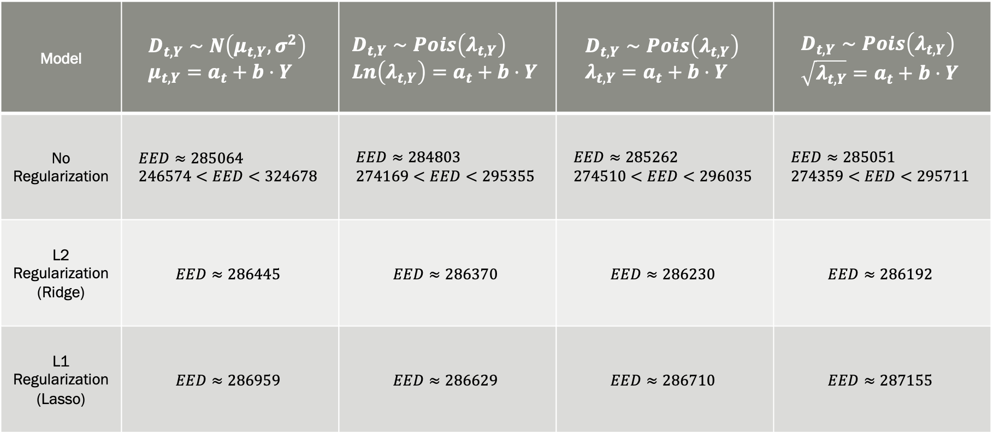
Model Selection Matrix – Excess Deaths
Model | $$D_{t,Y}∼N\left(μ_{t,Y},σ^{2}\right) \\ μ_{t,Y}=a_{t}+b⋅Y$$ | $$D_{t,Y}∼Pois\left(λ_{t,Y}\right) \\ Ln\left(λ_{t,Y}\right)=a_{t}+b⋅Y$$ | $$D_{t,Y}∼Pois\left(λ_{t,Y}\right) \\ λ_{t,Y}=a_{t}+b⋅Y$$ | $$D_{t,Y}∼Pois\left(λ_{t,Y}\right) \\ \sqrt{λ_{t,Y}}=a_{t}+b⋅Y$$
No Regularization | $$EED≈285064 \\ 246574<EED<324678$$ | $$EED≈284803 \\ 274169<EED<295355$$ | $$EED≈285262 \\ 274510<EED<296035$$ | $$EED≈285051 \\ 274359<EED<295711$$
L2 Regularization (Ridge) | $$EED≈286445$$ | $$EED≈286370$$ | $$EED≈286230$$ | $$EED≈286192$$
L1 Regularization (Lasso) | $$EED≈286959$$ | $$EED≈286629$$ | $$EED≈286710$$ | $$EED≈287155$$

Slide 45
Agenda
Introduction & Problem Statement
The Economist’s Methodology
Overview
Data & Assumptions
Shortcomings
Validation (Back-of-the-envelope)
Discussion
Concluding Remarks

Slide 46
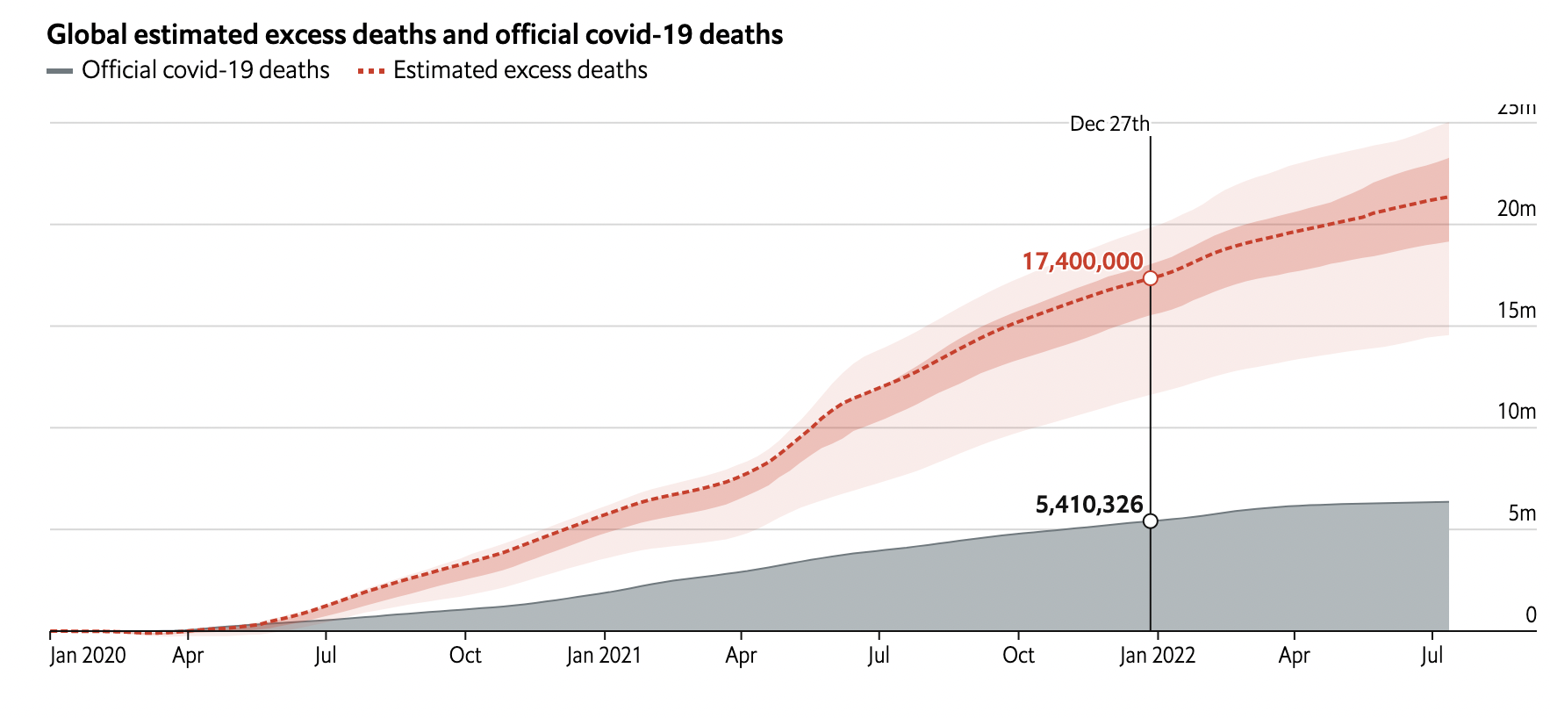
Model Comparison - Global
The Lancet also created a global excess death model.
Used an ensemble method (grouping multiple models together) to create estimates for expected mortality (in lieu of OLS)
Same basic principle, get as accurate estimates for excess deaths from first pass modelling
Then feed that into another model that tries to predict the excess mortality for countries where accurate mortality data is scarce.
Final model chosen, was a LASSO regression model using 15 covariates.
As of 31-Dec-2021, global excess mortality estimated at 18.2 million (95% CI: 17.1 – 19.6 million)
Over the same time period, The Economist’s model estimated

Slide 47
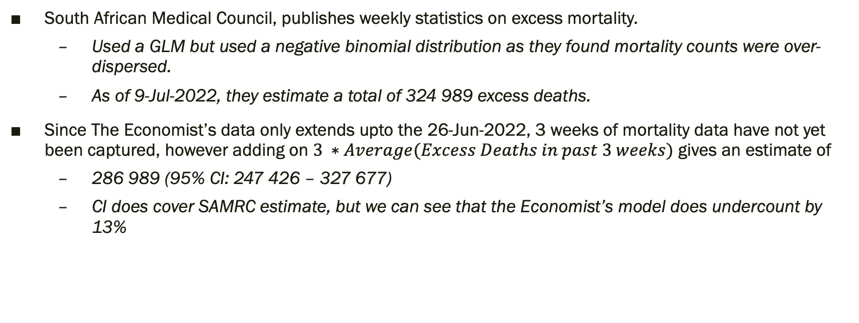
Model Comparison – South Africa
South African Medical Council, publishes weekly statistics on excess mortality.
Used a GLM but used a negative binomial distribution as they found mortality counts were over-dispersed.
As of 9-Jul-2022, they estimate a total of 324 989 excess deaths.
Since The Economist’s data only extends upto the 26-Jun-2022, 3 weeks of mortality data have not yet been captured, however adding on $3 ∗Average(Excess Deaths in past 3 weeks)$ gives an estimate of
286 989 (95% CI: 247 426 – 327 677)
CI does cover SAMRC estimate, but we can see that the Economist’s model does undercount by 13%

Slide 48
What can we conclude?
Extremely finnicky business
Enormous amounts of model selection, therefore space for subjective biases to creep it
Basically two independent verifications of a similar estimate for global mortality.
Initial model selection choices made by The Economist seem sound
Excess deaths do have a significant amount of explanatory power when viewed as proxy for the pandemic’s effect on global mortality
We need more national death registries.
Long COVID

Slide 49
THANK YOU

Slide 50
Sources
https://www.economist.com/graphic-detail/coronavirus-excess-deaths-estimates
https://github.com/TheEconomist/covid-19-excess-deaths-tracker (Model A)
https://github.com/TheEconomist/covid-19-the-economist-global-excess-deaths-model (Model B)
https://www.thelancet.com/action/showPdf?pii=S0140-6736%2821%2902796-3
https://www.samrc.ac.za/reports/report-weekly-deaths-south-africa?bc=254

